Slide 1
Speeding Up Multiscale Edge Detection
CS526 Project Report
Jimmy Dunn and Yahia Bakour
April 2019

Slide 2
Introduction
Multiscale edge detection is a common algorithm used in computer vision
Useful for tasks like segmentation and registration
Prime candidate for parallelization
For loops for shrinking, convolution, and enlarging are all embarrassingly parallel
Loop over different edge scales also embarrassingly parallel
Opportunities to use openACC, openMPI, and a smarter serial implementation

Slide 3

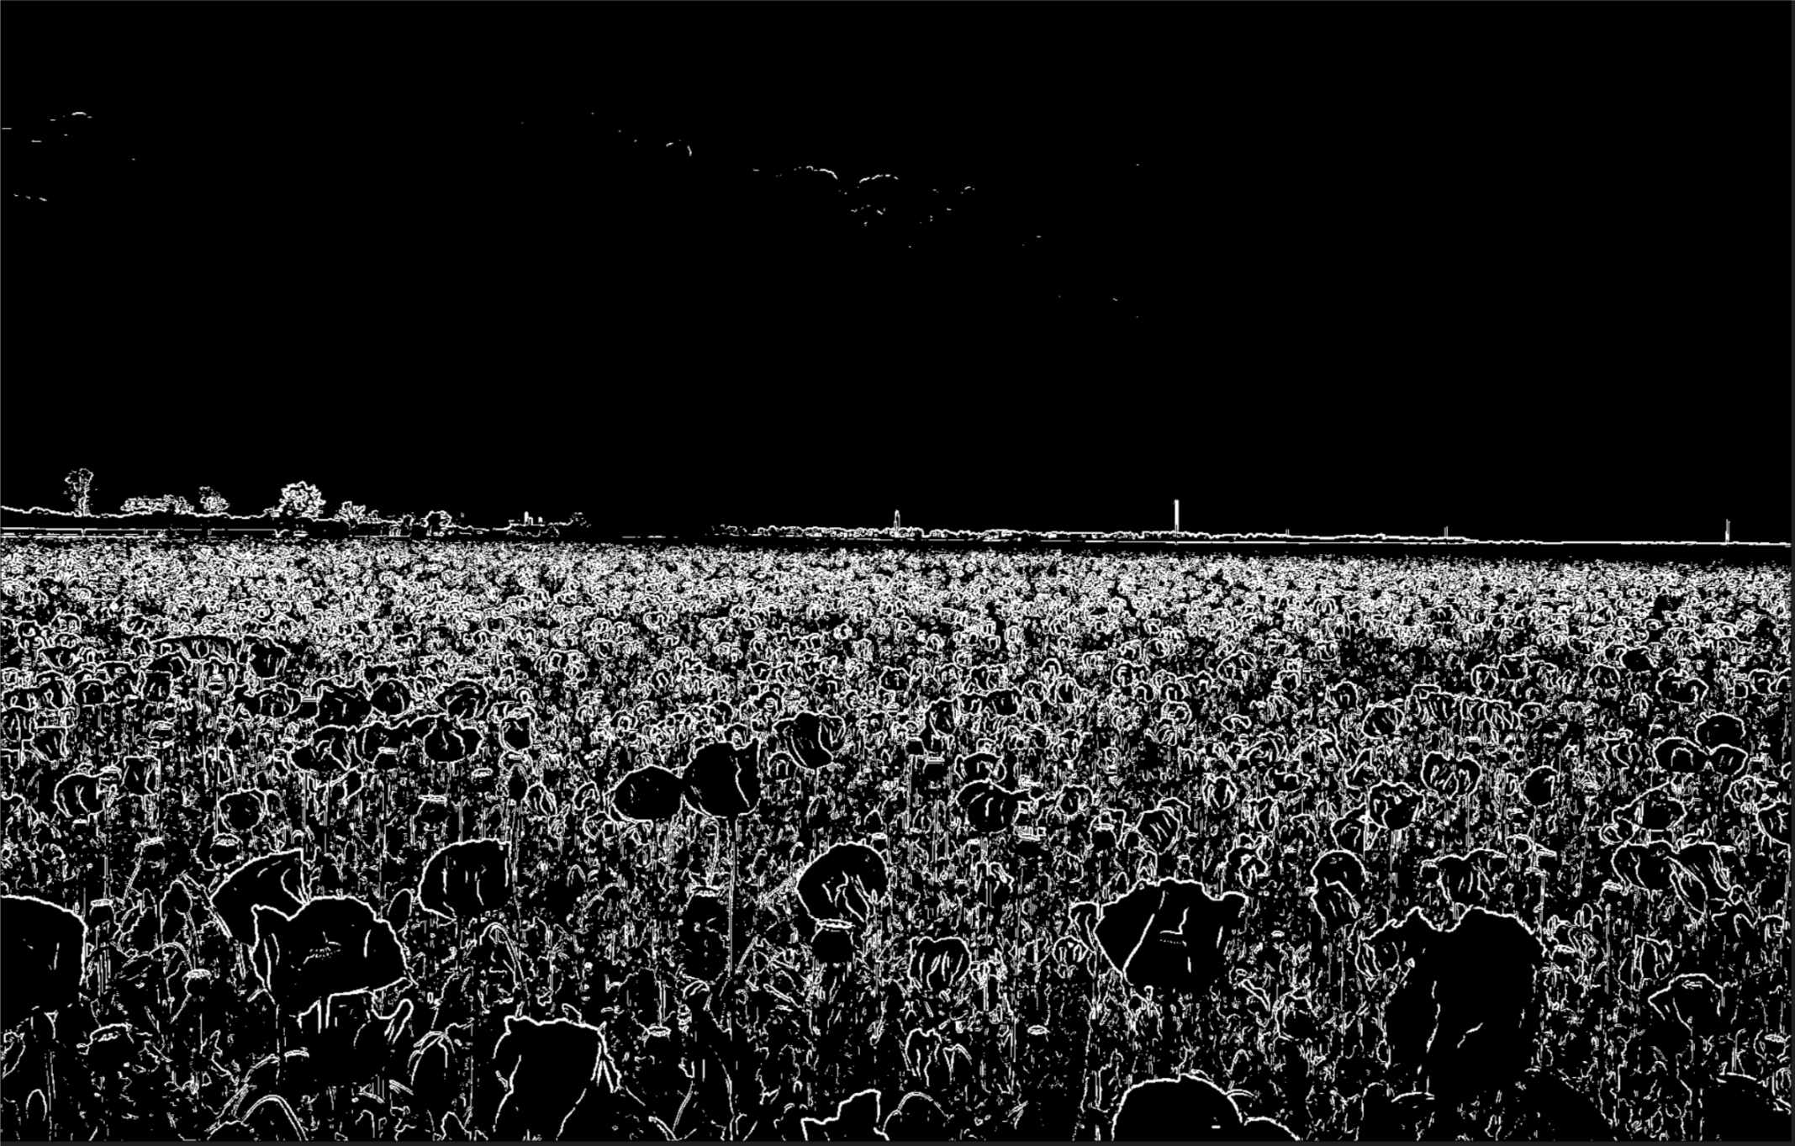
What is edge detection?
Calculated using our serial c++ code

Slide 4
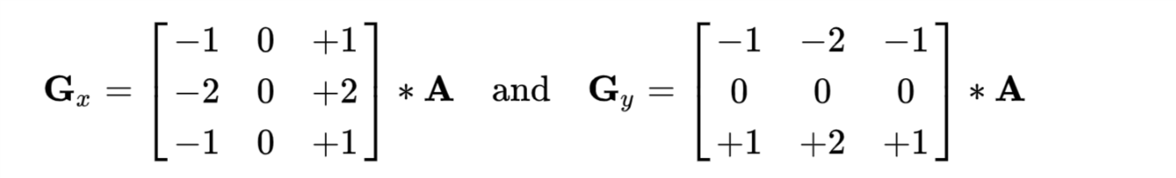
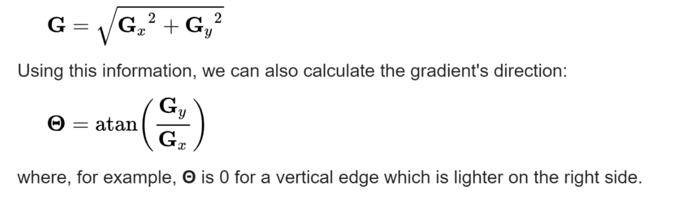
Sobel Edge Detection Algorithm
Original Image is first grayscaled then convolved with the two 3x3 kernels shown below
Source: https://en.wikipedia.org/wiki/Sobel_operator

Slide 5
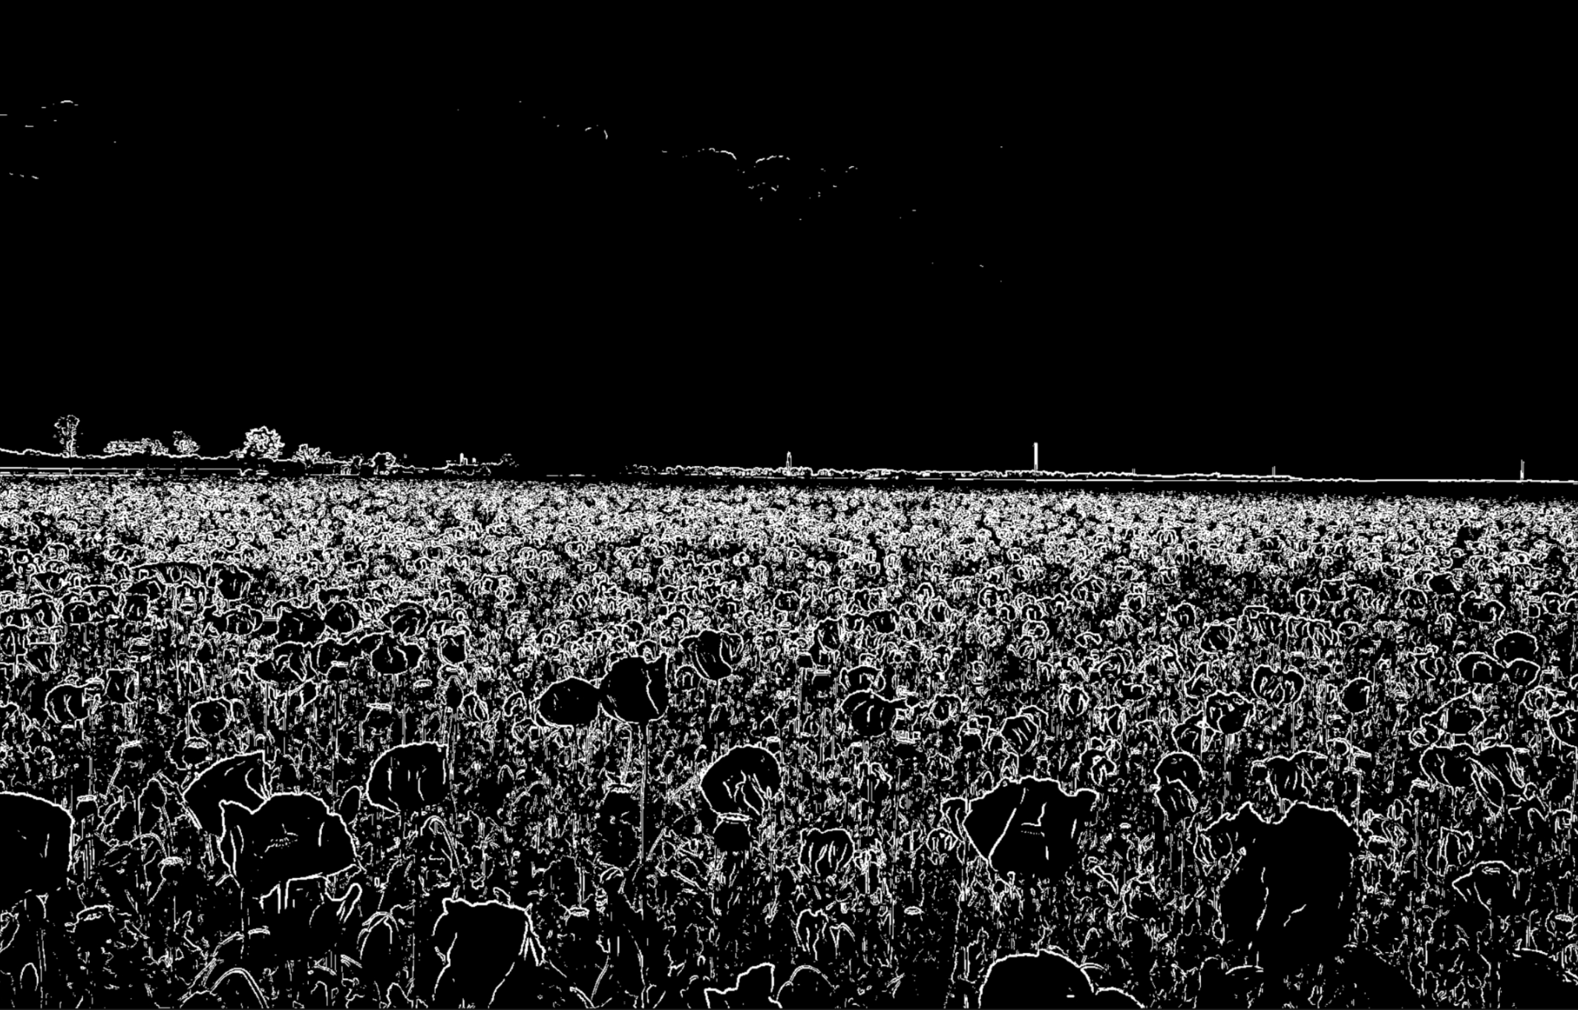
Multiscale Edge Detection Algorithm
Shrink Image
Run Edge Detection
Enlarge Image
Rinse & Repeat

Slide 6
Results of Multiscale
1x

Slide 7
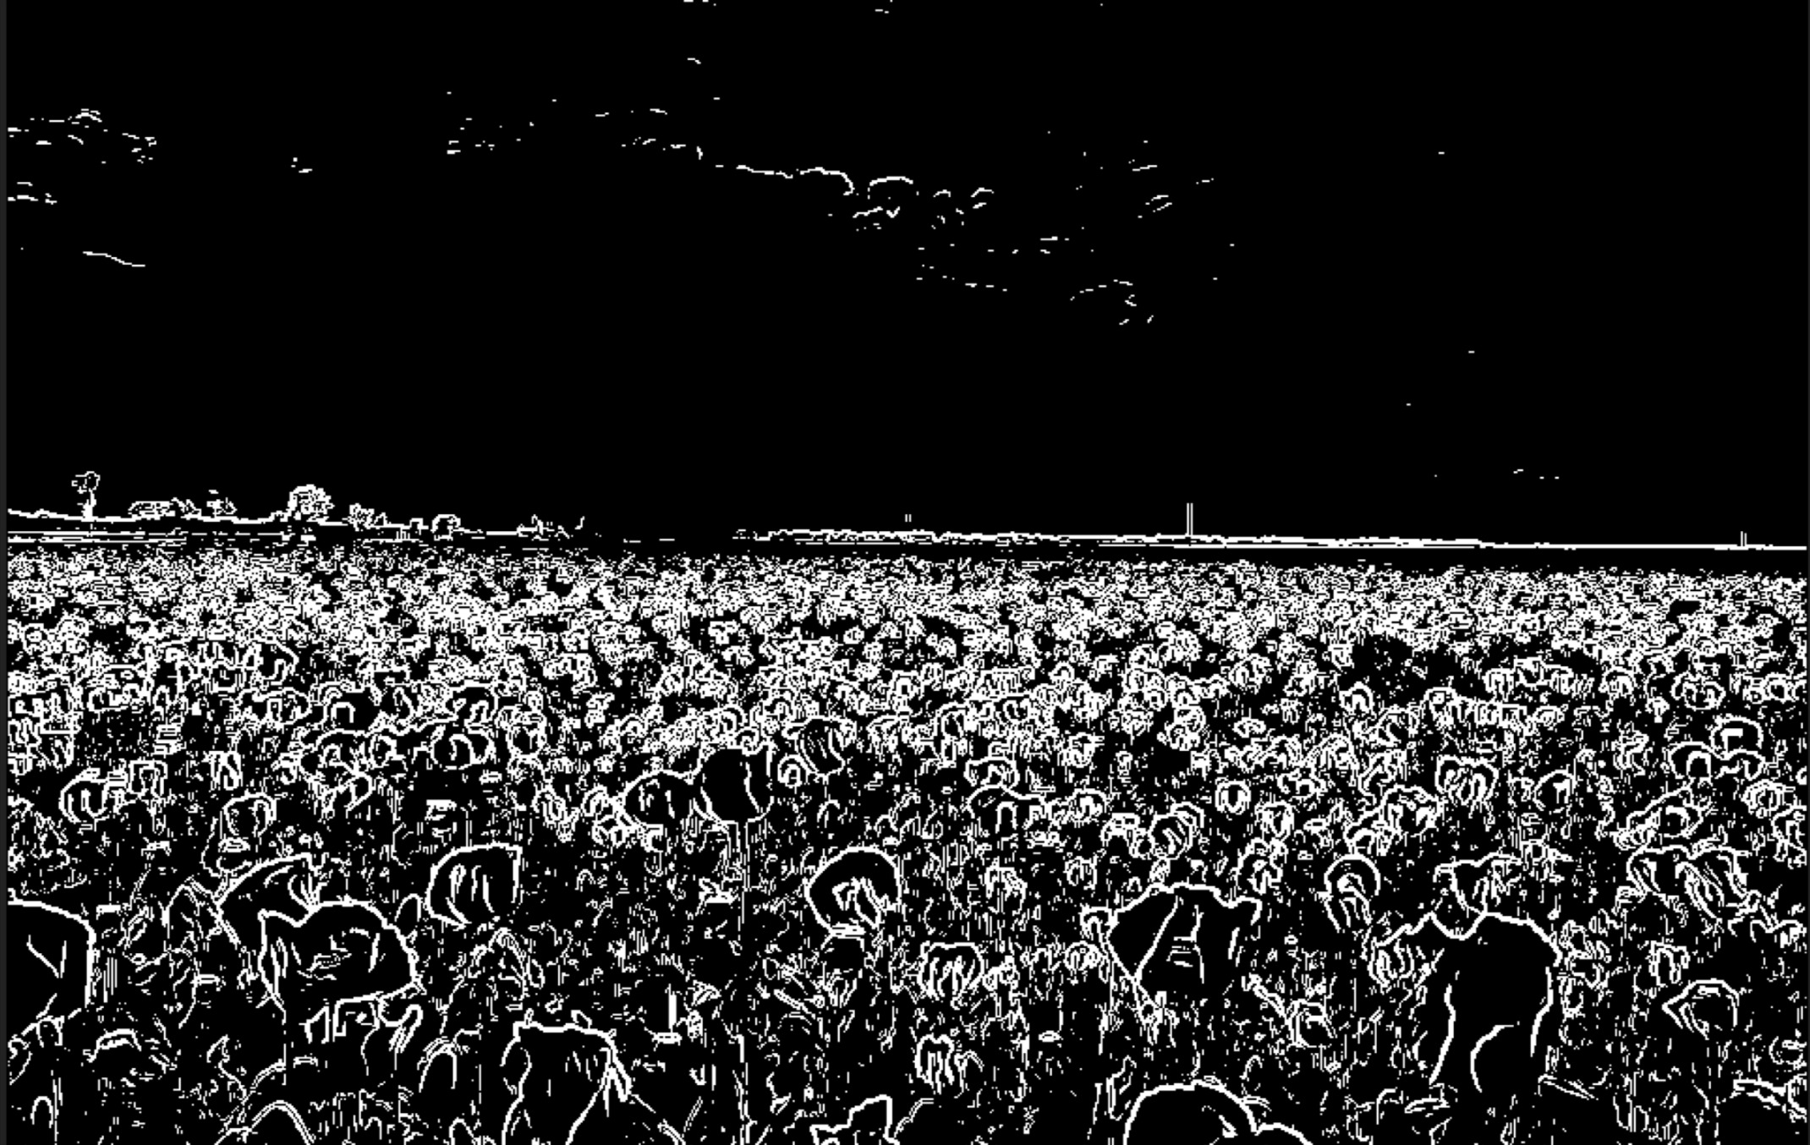
Results of Multiscale
2x

Slide 8
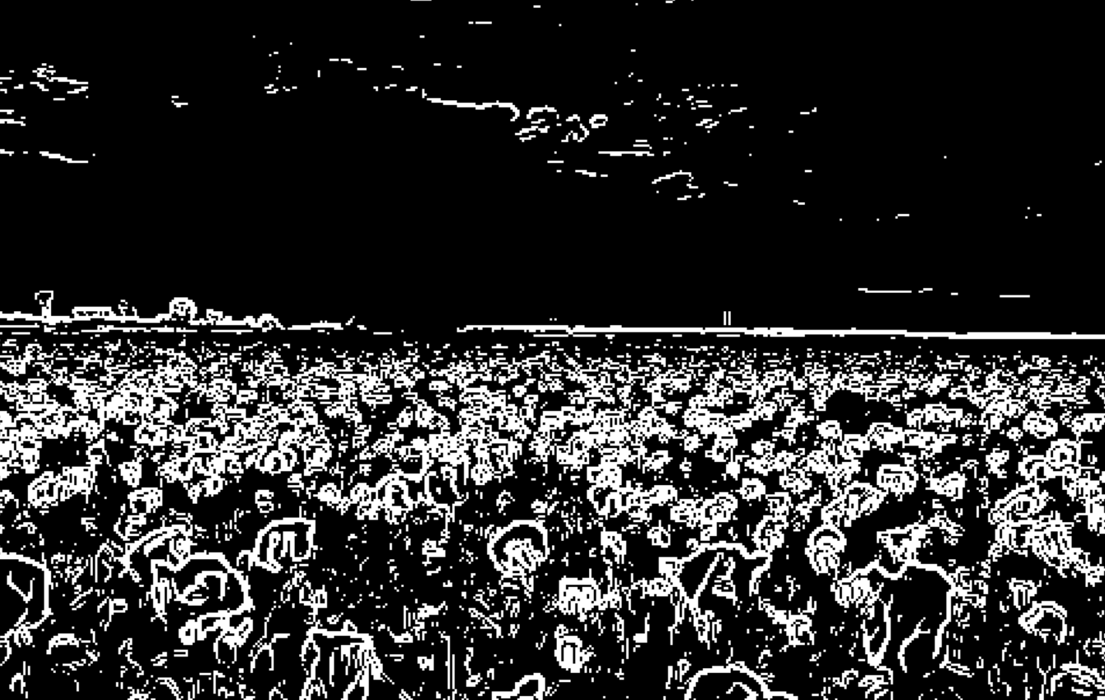
Results of Multiscale
4x

Slide 9
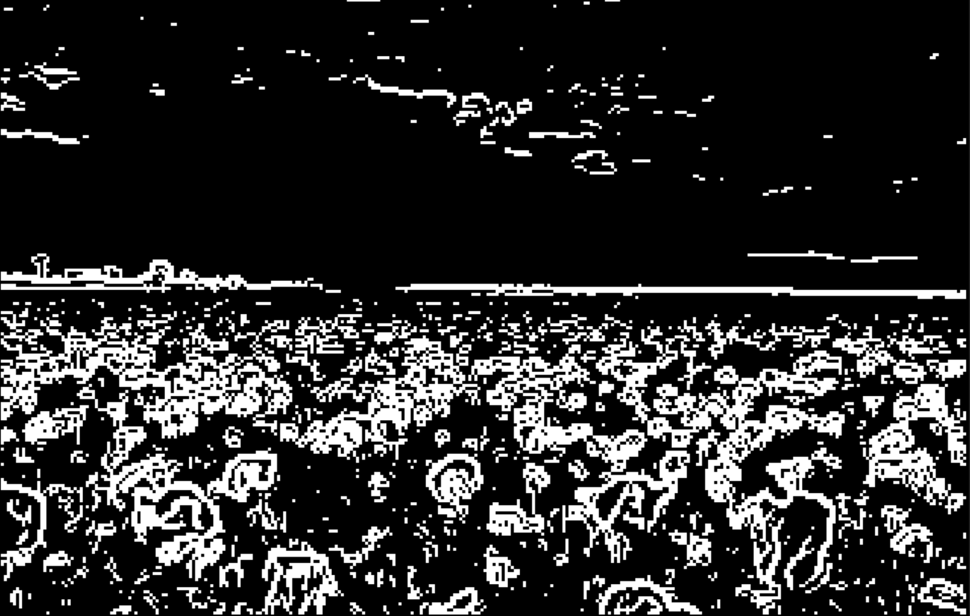
Results of Multiscale
6x

Slide 10
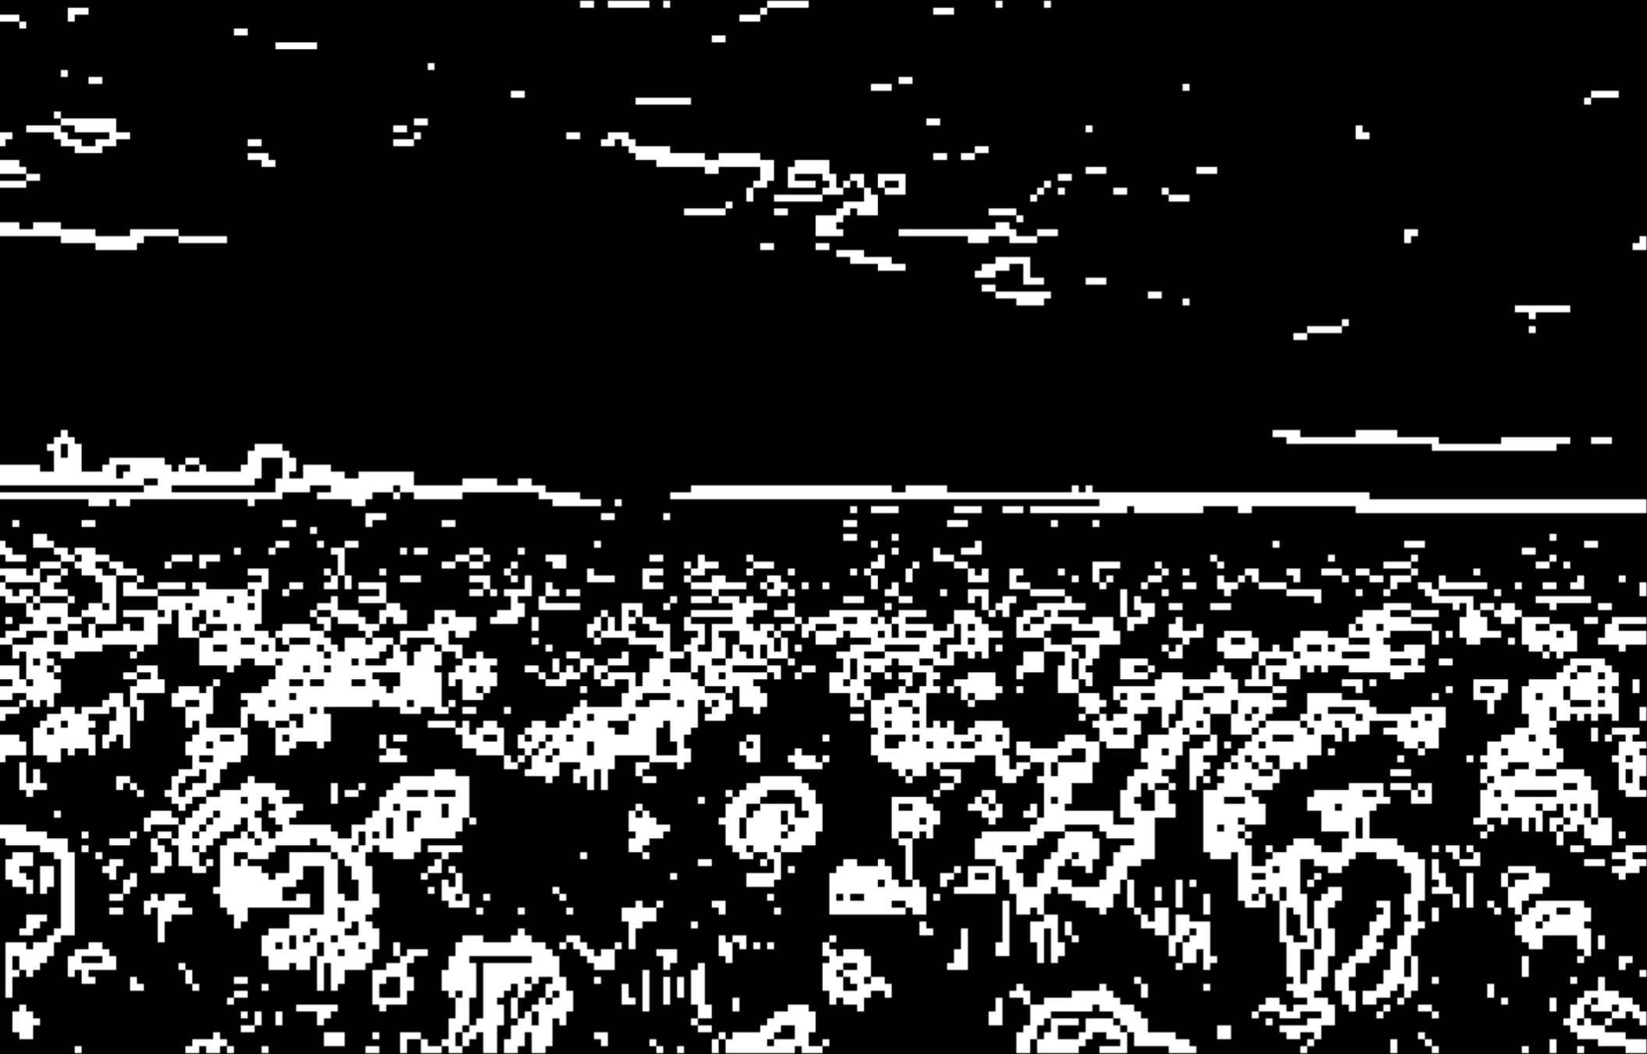
Results of Multiscale
8x

Slide 11
ACC Parallelization
Involved re-writing significant portions of code to remove backwards dependencies
Major breakthrough came from utilizing:
#pragma acc parallel loop collapse(n)
#pragma acc data present(ARRAY[:][:])
Removing data dependencies came at the cost of having very ugly serial code, but (nearly) perfectly written parallel code
Keeping data on the GPU and updating when necessary is key

Slide 12
Interesting examples of code changes made
TMPY[i][j] += pixels[yxc(i-1,j-1,0,nx,nc)]* GY00 + pixels[yxc(i,j-1,0,nx,nc)]* GY10 + pixels[yxc(i+1,j-1,0,nx,nc)]* GY20 + pixels[yxc(i-1,j,0,nx,nc)]* GY01 + pixels[yxc(i,j,0,nx,nc)]* GY11 +pixels[yxc(i+1,j,0,nx,nc)]* GY21 + pixels[yxc(i-1,j,0,nx,nc)]* GY02 + pixels[yxc(i,j,0,nx,nc)]* GY12 + pixels[yxc(i+1,j,0,nx,nc)]* GY22;
TMPX[i][j] += pixels[yxc(i-1,j-1,0,nx,nc)]* GX00 + pixels[yxc(i,j-1,0,nx,nc)]* GX10 + pixels[yxc(i+1,j-1,0,nx,nc)]* GX20 + pixels[yxc(i-1,j,0,nx,nc)]* GX01 + pixels[yxc(i,j,0,nx,nc)]* GX11 +pixels[yxc(i+1,j,0,nx,nc)]* GX21 + pixels[yxc(i-1,j,0,nx,nc)]* GX02 + pixels[yxc(i,j,0,nx,nc)]* GX12 + pixels[yxc(i+1,j,0,nx,nc)]* GX22;
No one does this serially

Slide 13
Interesting examples of code changes made
// Find edges at various coarser resolution levels. Output must be preallocated.
void findMultiscaleEdges(uint8_t *input, uint8_t **output, int *levels, int nlevels, int ny, int nx, int nc) {
#pragma acc data copyin(input[0:nx*ny*nc])
{
// Find edges at each of the downsampling levels in levels array and place into output
for (int l=0;l<nlevels;++l) {
int factor = levels[l];
// Shrink image to smaller level
uint8_t *small_img = new uint8_t [ny*nx*nc/(factor*factor)];
shrink(input, small_img, ny, nx, nc, factor);
// Detect edges of the shrunk image
findEdges(small_img, output[l], ny/factor, nx/factor, nc);
delete [] small_img;
}
}

Slide 14
MPI Parallelization
Parallelization done across image scales
Serial within an image scale
Straightforward implementation: each rank runs the shrink-edge detect-enlarge for a single scale factor
Not the best way, but was much easier to code
Should reduce total runtime to that of a single full-scale image

Slide 15
FFT Convolution Method
Fourier convolution theorem speeds up convolutions from O(N²) to O(Nlog₂(N))
image ⊗ kernel = invFFT(FFT(image) * FFT(kernel))
PROBLEM: our Sobel kernel is only 3x3
Image is much larger (eg. 1920x1232)
Must zeropad kernel to same size as image to use FFT method
Hope for 9N² -> 2log₂(3) Nlog₂(N)
Actually get 9N² -> 2N²log₂(N)
Ends up being much slower, only because we use small 3x3 kernels

Slide 16
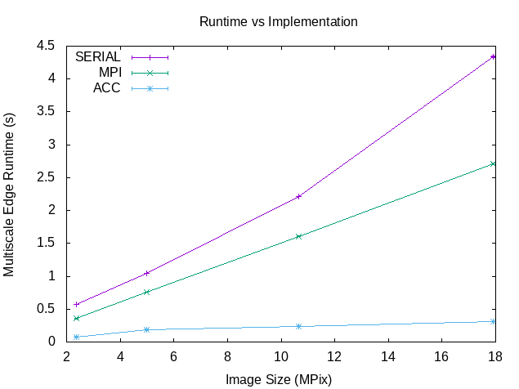
Resulting Runtimes
ACC Speedup of about 8x on small image
ACC Speedup of about 14x on large image
MPI speedup of about 1.6x
Splits up multiscale task but bottle-neck remains in the edge detection algorithm
FFT method (not shown) about 161x slower than serial, primarily because of zeropadding the 3x3 kernel
For larger kernels (47x47 pix and larger), FFT method beats serial

Slide 17
Conclusions
Multiscale edge detection is a prime candidate for parallelization
openACC on a Tesla GPU offers about 14x speedup
MPI across the scales offers a 1.6x speedup
FFT convolution method is 161x slower
Kernel must be zeropadded, many array copies, int -> complex
MPI+ACC should be even better
i.e. Use MPI to run different scales across multiple GPUs
Did not have time to shoehorn pgc++ into MPI to do this
Tried a few avenues with no success (including SCC’s own instructions)

Slide 18
References
“Sobel operator” , https://en.wikipedia.org/wiki/Sobel_operator, accessed 4/21/19
“Purple Petaled Flower Field”, https://www.pexels.com/photo/purple-petaled-flower-field-1131407/, accessed 4/27/19
“Convolution Theorem”, https://en.wikipedia.org/wiki/Convolution_theorem, accessed 4/25/19
“OpenACC Tutorial - Data movement”, https://docs.computecanada.ca/wiki/OpenACC_Tutorial_-_Data_movement#C.2B.2B_Classes, accessed 4/24/19
“Advanced OpenACC” , http://icl.cs.utk.edu/classes/cosc462/2017/pdf/OpenACC_3.pdf, accessed 4/23/19
“Architecture-cliffside-cold”, https://images.pexels.com/photos/789380/pexels-photo-789380.jpeg?cs=srgb&dl=architecture-cliffside-cold-789380.jpg&fm=jpg , accessed 4/22/19
“Multiprocessor Programming: TechWeb : Boston University”, http://www.bu.edu/tech/support/research/software-and-programming/programming/multiprocessor/#MPI accessed 4/30/19
“OpenACC + MPI”, http://www.speedup.ch/workshops/w43_2014/tutorial/html/openacc_mpi_1.html, accessed 4/30/19

